Slide 1
Disc Friction
Dr. Jacob Moore
Associate Professor of Engineering
Penn State Mont Alto

Slide 2
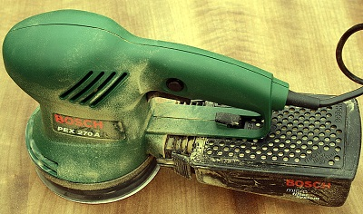
Disc Friction
Disc friction is the friction that exists between rotating circular surface and the surface it is rotating against.
Occurs whenever there is relative motion.
Image by Hedwig Storch CC-BY-SA 3.0

Slide 3
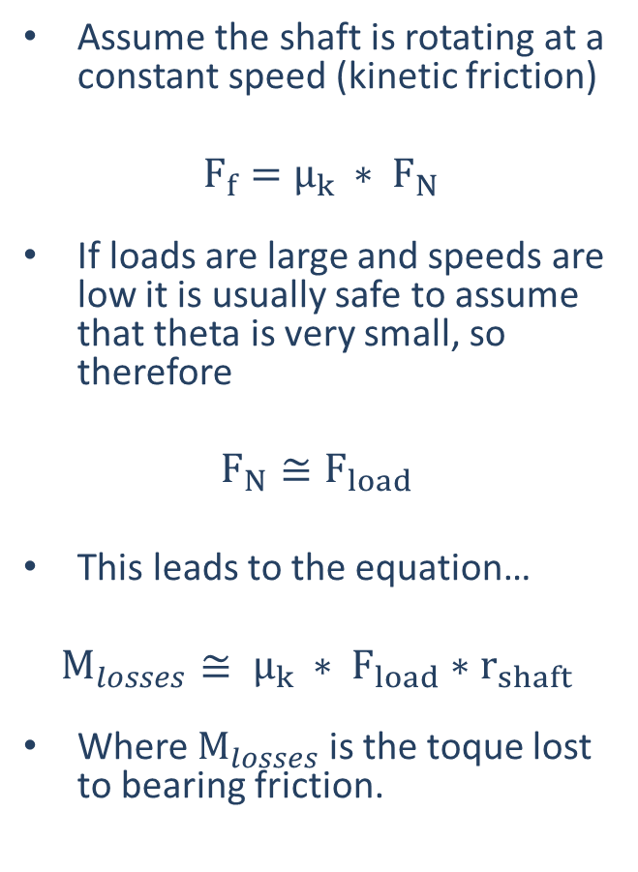
Thrust Bearing
$$F_{Load}$$
$$F_{Load}$$
End Bearing
Collar Bearing

Slide 4







Disc Friction
For the surfaces in contact, the friction force will be the same at all locations, but the moment exerted by the friction forces will not be the same.
$$F_{f}=μ_{k} F_{N}$$
$$M_{o}$$
$$M_{i}$$
$$F_{i}$$
$$F_{o}$$
$$F_{i}=F_{o}$$
$$M_{i} ≠M_{o}$$

Slide 5




Disc Friction
$$F_{Load}$$
M
$$M= \int_{A}^{ }{dM}=\int_{A}^{ }{μ_{k}∗ p∗ r ∗dA}$$
$$M=μ_{k }\frac{F_{load}}{π(R_{o}^{2}−R_{i}^{2})}\int_{R_{i}}^{R_{o}}{r∗\left(2πr\right) dr}$$
$$M=\frac{2}{3} μ_{k} F_{Load} \left(\frac{R_{o}^{3}−R_{i}^{3}}{R_{o}^{2}−R_{i}^{2}}\right)$$
$$R_{o}$$
$$R_{i}$$

Slide 6


Disc Friction
$$F_{Load}$$
M
For instances where we have a solid circular contact area, we can set the inner radius to zero, leaving us with...
$$M=\frac{2}{3} μ_{k} F_{Load}{ R}_{o}^{}$$
$$R_{o}$$
Contact Area

Slide 7
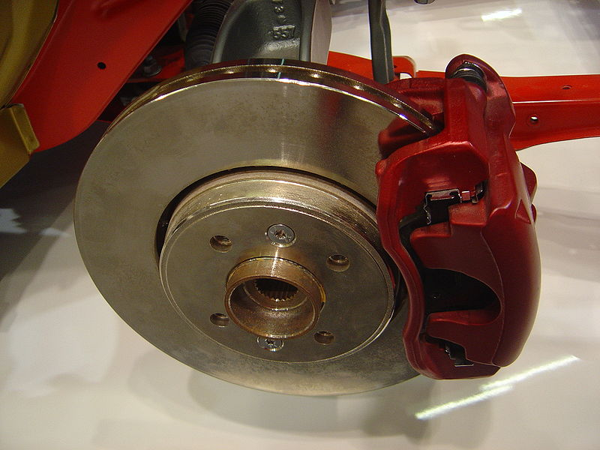
Disc Brakes
Disc brakes are similar in many ways to thrust bearings, and we will analyze them in a very similar way.
Image by David Monniaux CC-BY-SA 3.0

Slide 8


Disc Brakes
Θ
The diagram contact area between the stationary brake pad and the rotating disc will be a section of what we had for the collar bearing.
This decreases the area exerting the friction force.
However, this increases the pressure in the contact area.
In the end, these two factors cancel each other out, leading to the same friction force as in the original scenario
$$R_{o}$$
$$R_{i}$$

Slide 9
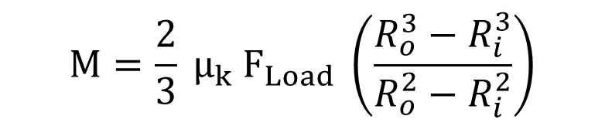
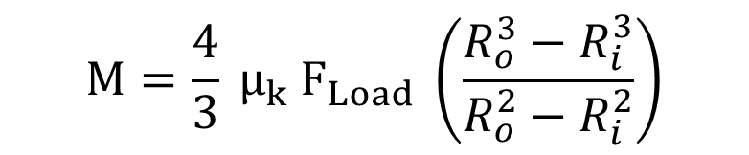
Disc Brakes
Θ
Single Brake Pad
$$M=\frac{2}{3} μ_{k} F_{Load} \left(\frac{R_{o}^{3}−R_{i}^{3}}{R_{o}^{2}−R_{i}^{2}}\right)$$
$$R_{o}$$
$$R_{i}$$
Brake Pad on Each Side
$$M=\frac{4}{3} μ_{k} F_{Load} \left(\frac{R_{o}^{3}−R_{i}^{3}}{R_{o}^{2}−R_{i}^{2}}\right)$$

Slide 10
Thanks for Watching
See other engineering mechanics videos and access the full tool at…

Slide 11
Disc Friction Worked Example
A disc sander is pressed against a surface with a force of 50 N. Assuming the kinetic coefficient of friction between the sandpaper and the wood is .6 and the diameter of the sanding disc is .2 meters, determine the torque the motor must produce to keep the disc spinning at a constant rate.
Image by Hedwig Storch CC-BY-SA 3.0

Slide 12


Disc Brake Worked Example
In the disc brake setup shown below, a pair of brake pads is pressed into the rotor with a force of 300 lbs. If the kinetic coefficient of friction between the brake pads and the rotor is .4, find the stopping torque exerted by the brake pads.
$$8 in$$
60º
$$6 in$$
Image by David Monniaux CC-BY-SA 3.0

